Slide 1
liveability
Yr 7 Geography

Slide 2
Liveability
Learning Intention
Success Criteria
Explore and understand the concept of liveability
Define the term liveability
Identify and outline the factors that affect liveability.

Slide 3

Liveability
The qualities of a place (city, town, suburb, neighbourhood) that contribute to the quality of life experienced by residents and others.

Slide 4
Liveability
List as many reasons why you live where you do in 60 seconds.
Why do you live where you do?
Progress Bar
Timer – 60 Seconds!

Slide 5

Unit objectives
Our goal for this unit of work to be able to answer the following questions:
1. What factors influence people’s decision on where they live?
2. Why do you enjoy or not enjoy where you live?
3. How is the liveability of places measured?
4. How do the liveability factors of climate, environmental quality,
infrastructure, safety and stability and access to health care and education
impact people around the world?
5. What factors do planners of new developments have to consider?

Slide 6

Lesson objectives
Learning Intentions
Understand the concept of liveability and why we live where we do.
Success Criteria
Define liveability
List factors that influence liveability

Slide 7


brainstorm
What I like about where I live?
What I dislike about where I live?

Slide 8

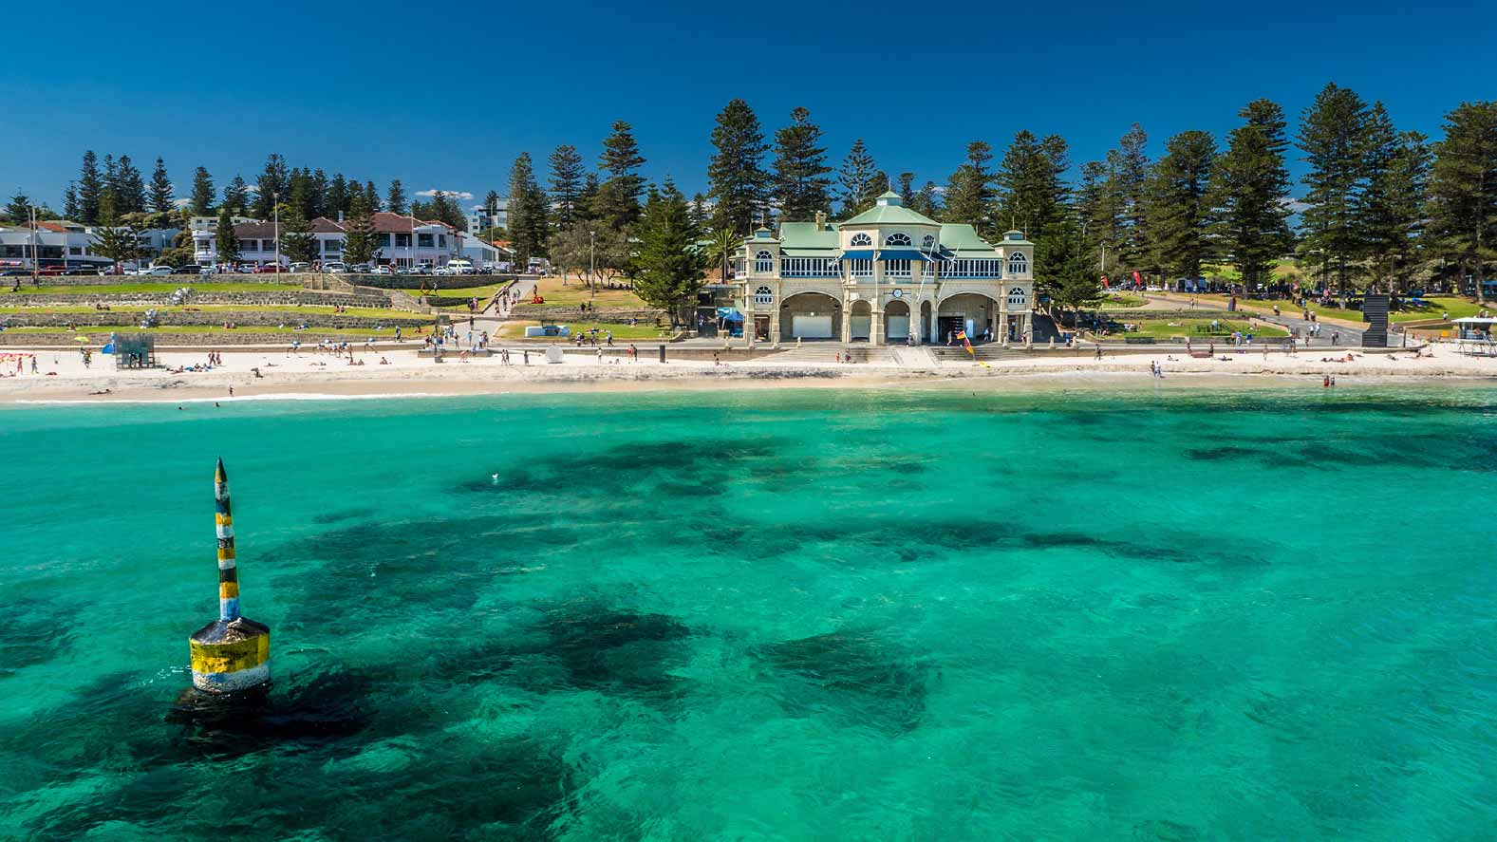
1. Attachment to place
We all develop an attachment to places that are special to us. It may be the place in which were born and grew up.

Slide 9

2. Distance from family and friends
Being close to family and friends is a powerful factor influencing people’s decisions about where to live. Family and friends provide emotional and practical support and meet one of our most basic needs- the need for relationships.

Slide 10

3. Employment opportunities
Earning an income to support yourself and your family is an important factor in deciding where to live. For example, many people move to Port Hedland because of jobs in mining.

Slide 11
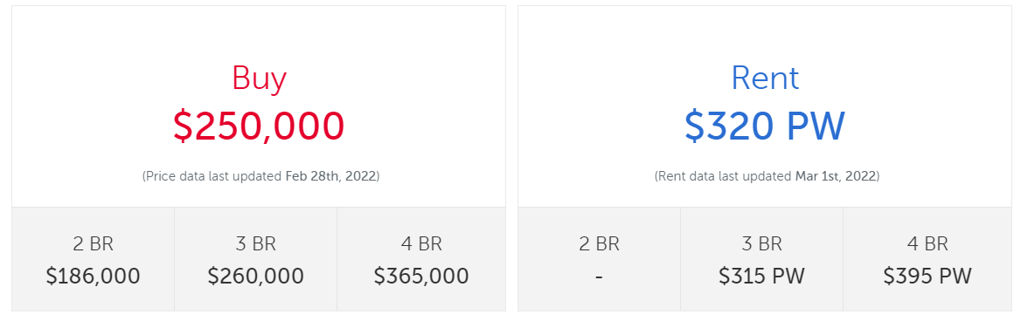
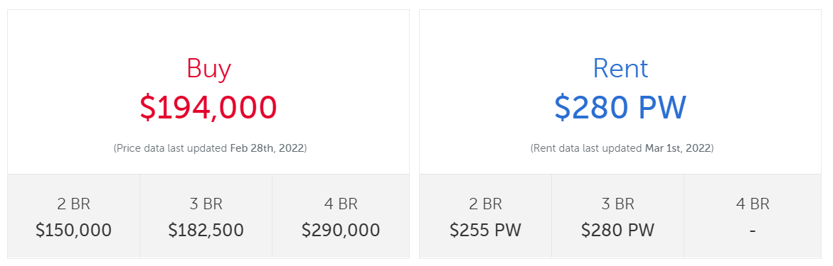
4. Affordability (price of living)
If a person earns more money, they have more options for where to live. Wealthy people can afford to buy or rent housing in the nicer suburbs.
Northam
Narrogin

Slide 12
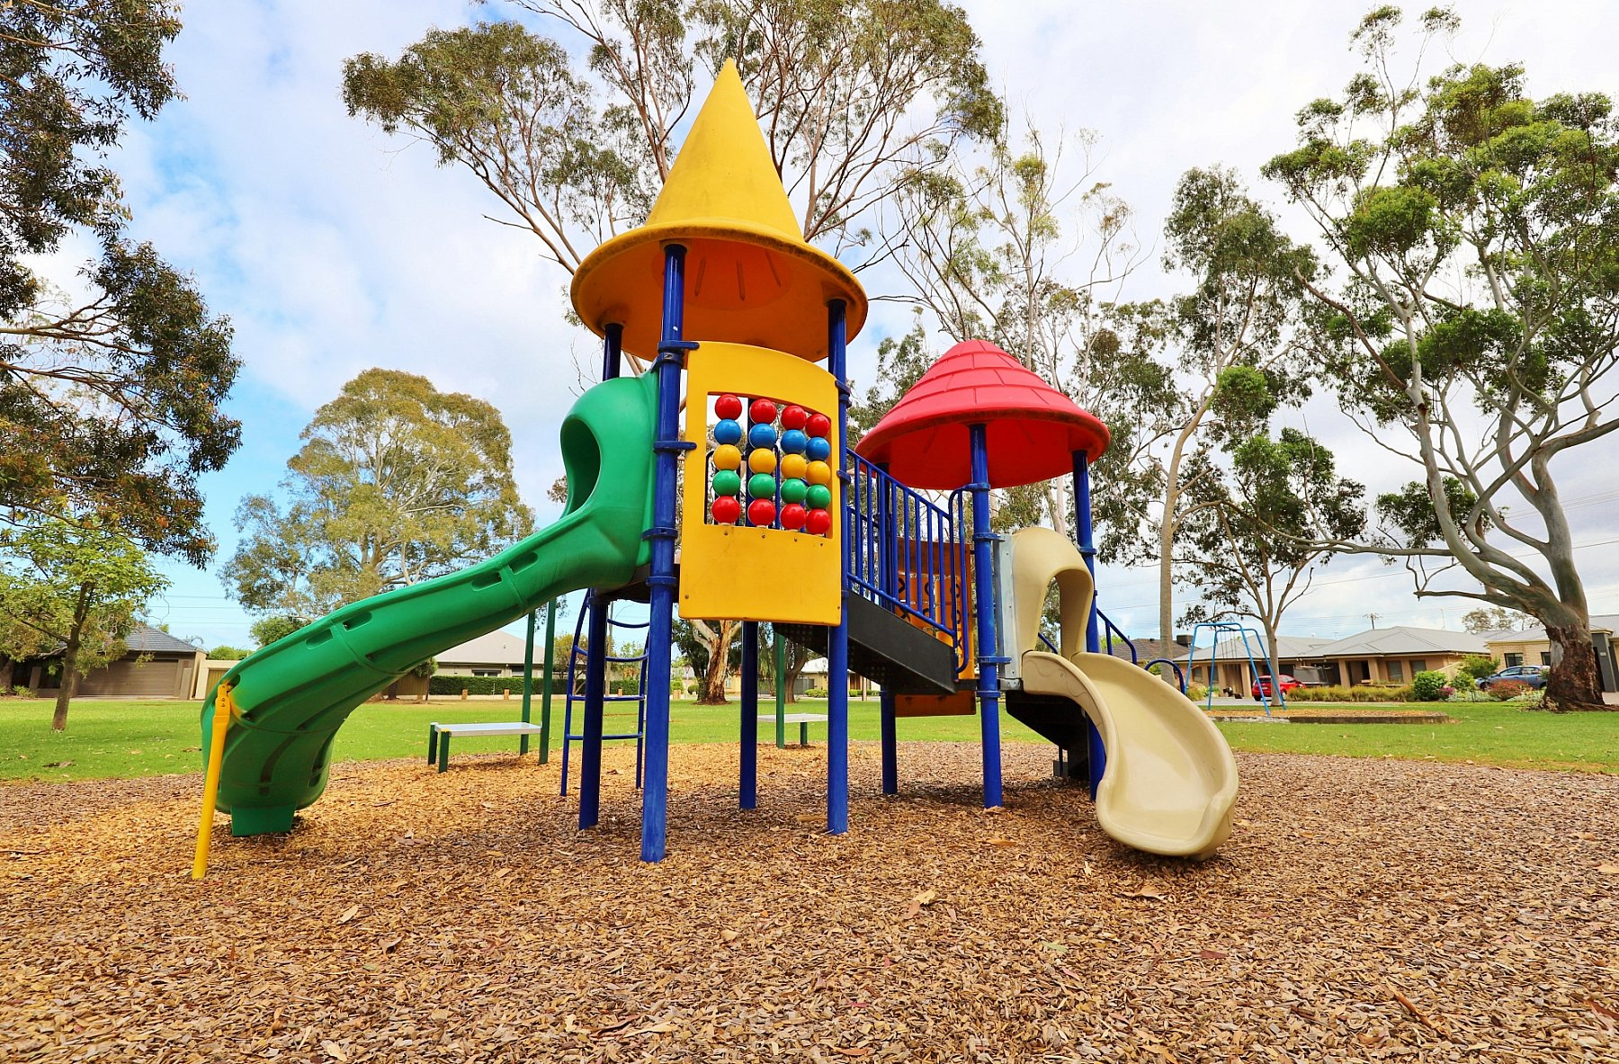

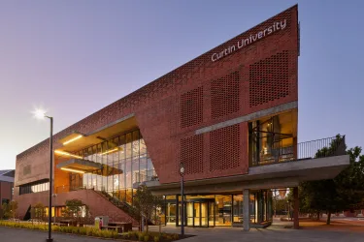
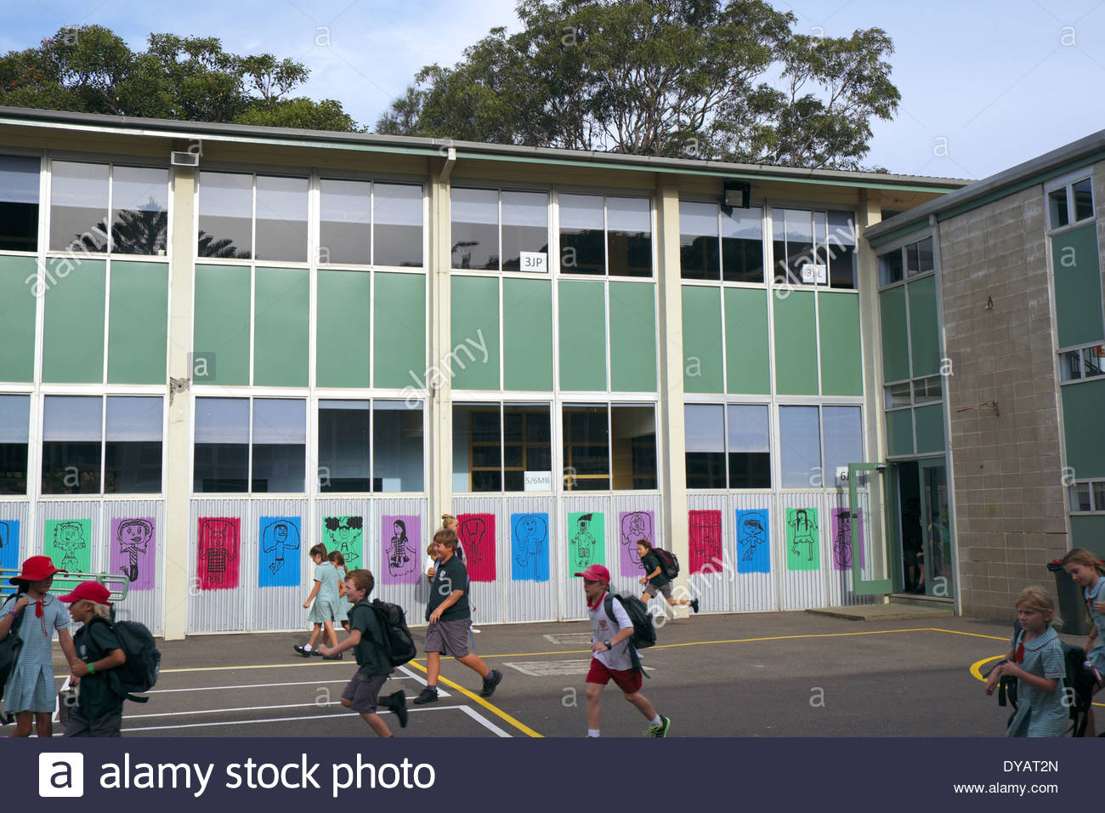



5. Stage of life
Where you want to live will likely change throughout your life. When you are young, you live where your parents decide to buy or rent a home. In your 20s, you may live in rented group housing with friends. For older people, access to good healthcare is important. For young families, access to good schools may be important.

Slide 13


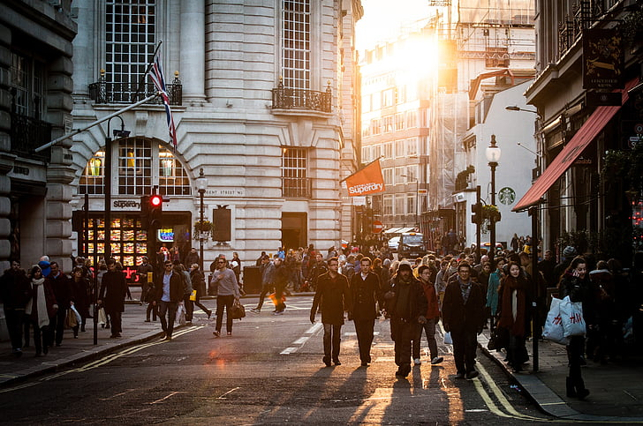
6. Lifestyle
Different people have different ways that they like to live their lives. Some people choose to live in the country; others find the coastal lifestyle more appealing

Slide 14
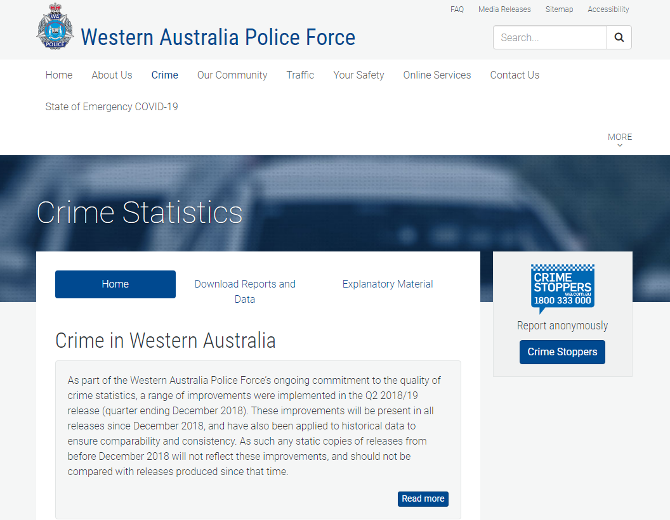
7. Personal safety
https://www.police.wa.gov.au/Crime/CrimeStatistics#/
The level of crime in an area can influence someone’s decision to live there. People who can afford to live elsewhere avoid areas with high crime rates

Slide 15
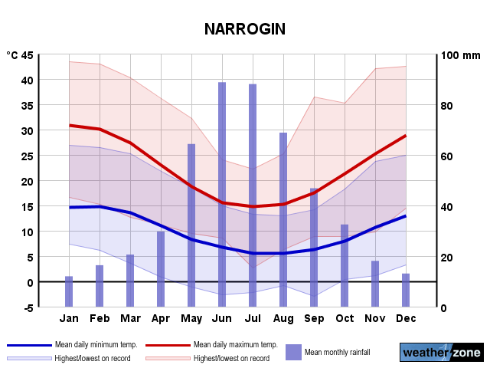

8. Environmental Factors (e.g. Climate)
People’s decisions about where they live are influenced by climate and the environment. Some move to cooler places whilst others prefer the heat.

Slide 16
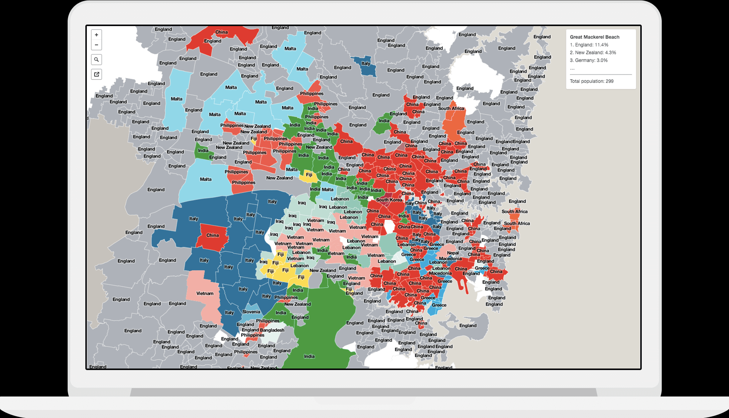
9. Culture and ethnicity
https://smallmultiples.com.au/projects/mapping-immigrants-birth-places/
New immigrants often settle in suburbs with a community of people from a common cultural or ethnic background. This provides them with a support network that makes settling into their new homeland easier.

Slide 17
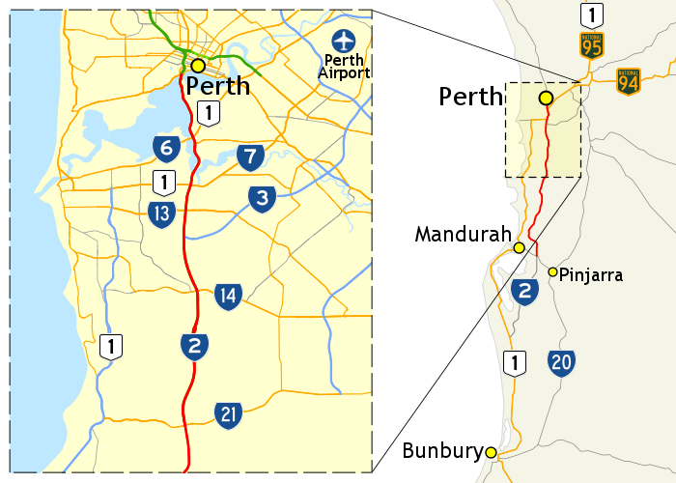
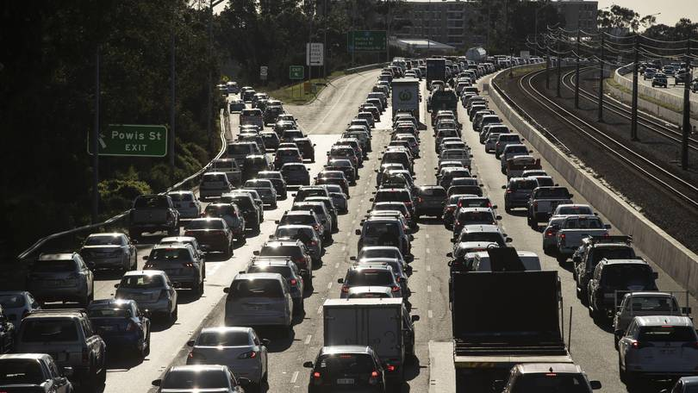
10. Travel time and transport options
Some people choose to live close to where they work. Access to public transport is an important factor for people living in large cities with lots of traffic.

Slide 18
Application of learning
Image analysis

